Slide 1
Kiosk Payment Systems, LLC
Automated Cashier System Utilizing Digicomm’s DigiCourt System
www.kioskps.com

Slide 2
Payment Options Accepted
The automated cashier kiosk accepts full or partial payments of citations, fines, and fees by cash or card.
All US dollar denominations ($1, $2, $5, $10, $20, $50 & $100) are accepted using high quality, high volume cash acceptors that are impenetrable by counterfeit currency.
Card readers currently accept all valid credit/debit/charge cards and are EMV compliant.
The automated cashiers are best paired with a backend payment system (your current management software) for seamless handling of payments and balances, eliminating theft, mishandling of funds and reducing workload.
Payment options such as minimum payments with due dates can be additionally set using a backend payment system.

Slide 3
Main Screen
The Main Screen allows users to select which payment option they wish to use, either Pay With Cash or Pay With Card.

Slide 4
Cash Payment Screen
Selecting Pay With Cash, the user can then enter the citation, docket or fee number they wish to pay.
After verifying the correct citation to pay, the user will then select or enter an amount to pay.
Once terms are accepted, they will be prompted to insert their cash into the cash acceptor.
Counterfeit bills, mutilated money, and foreign denominations are immediately rejected by the cash acceptor.
Cash is deposited in a canister locked secure within the kiosk.
A receipt of payment will then be printed concluding the transaction.
An email receipt is immediately sent to a predetermined address to ensure a proper record of the transaction.

Slide 5
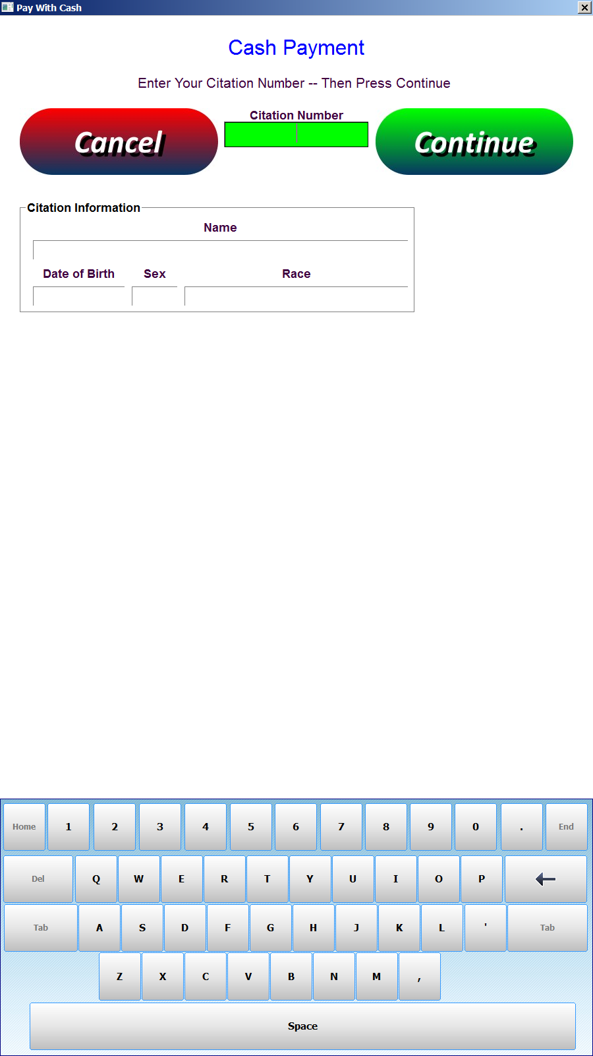
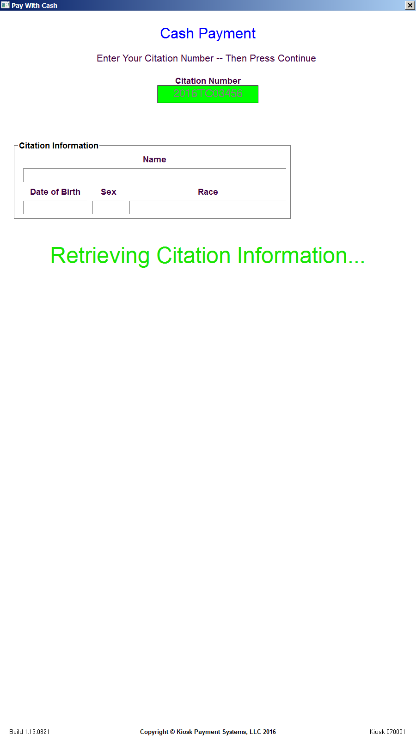
Cash Payment Screenshots

Slide 6
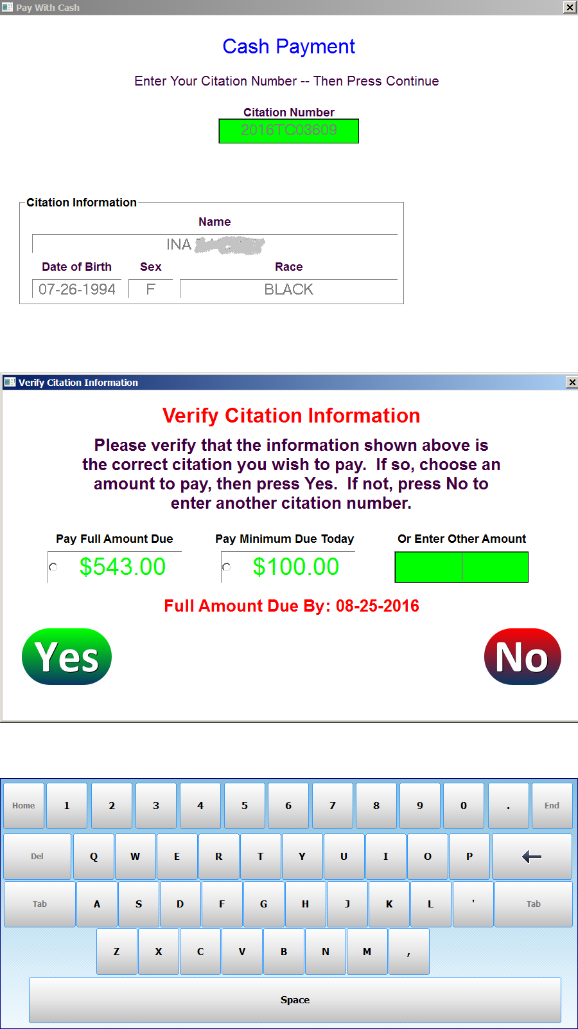
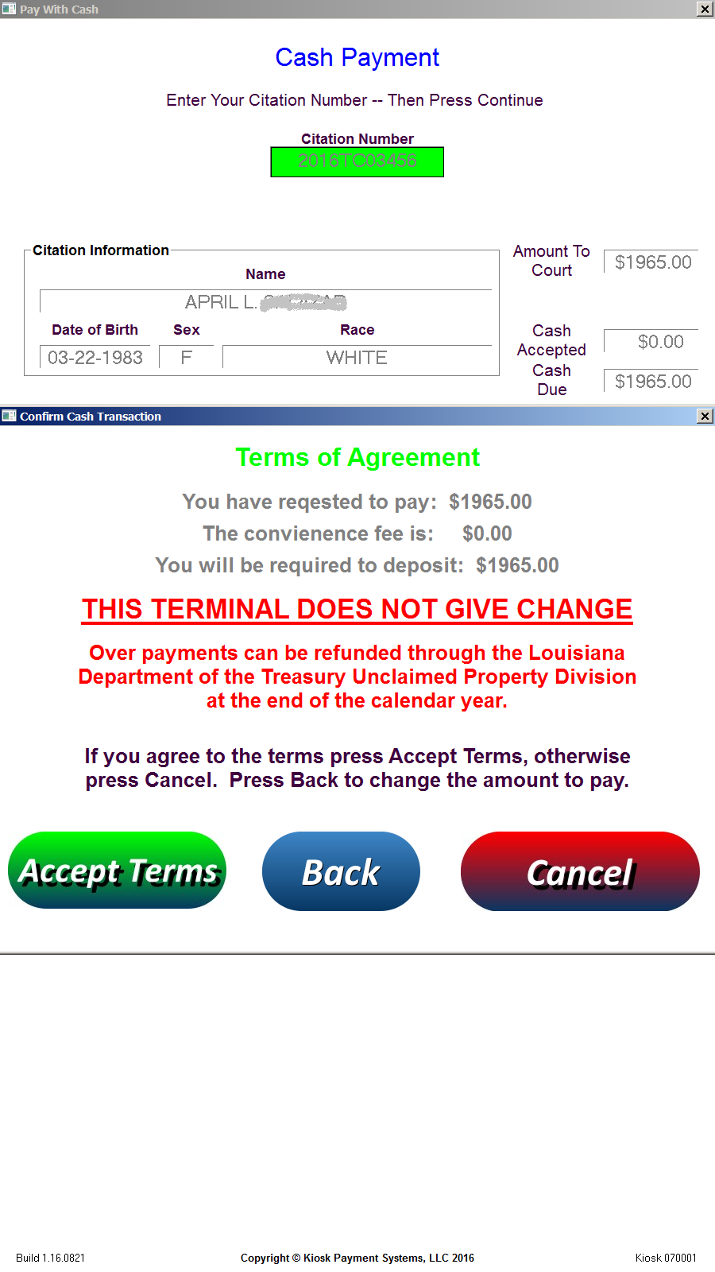
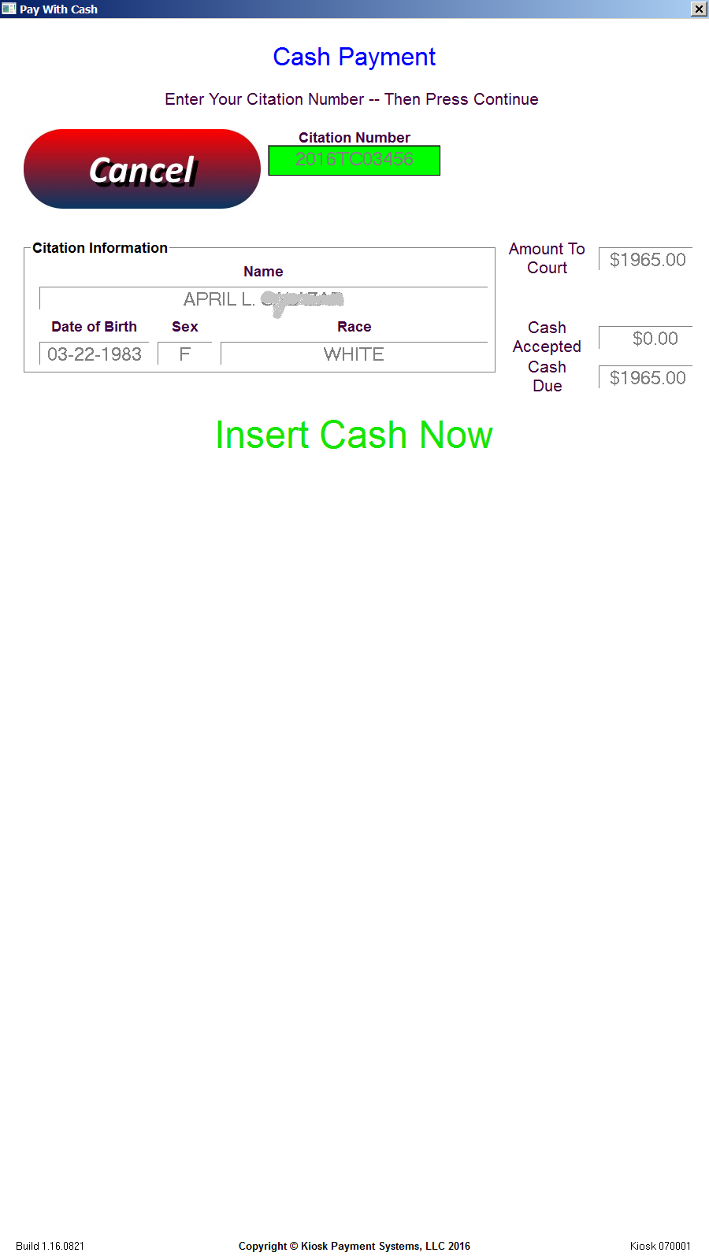
Cash Payment Screenshots

Slide 7
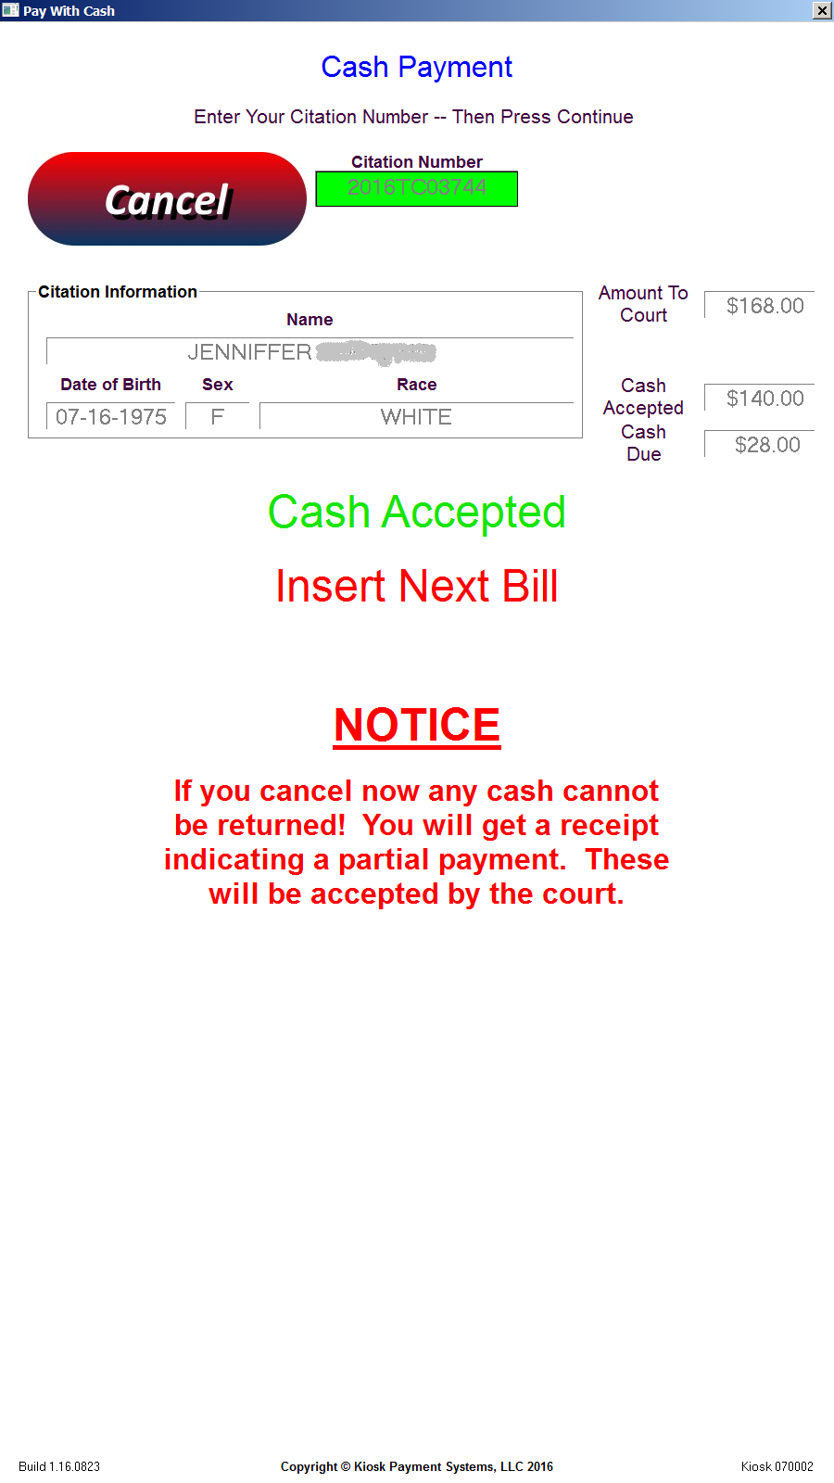
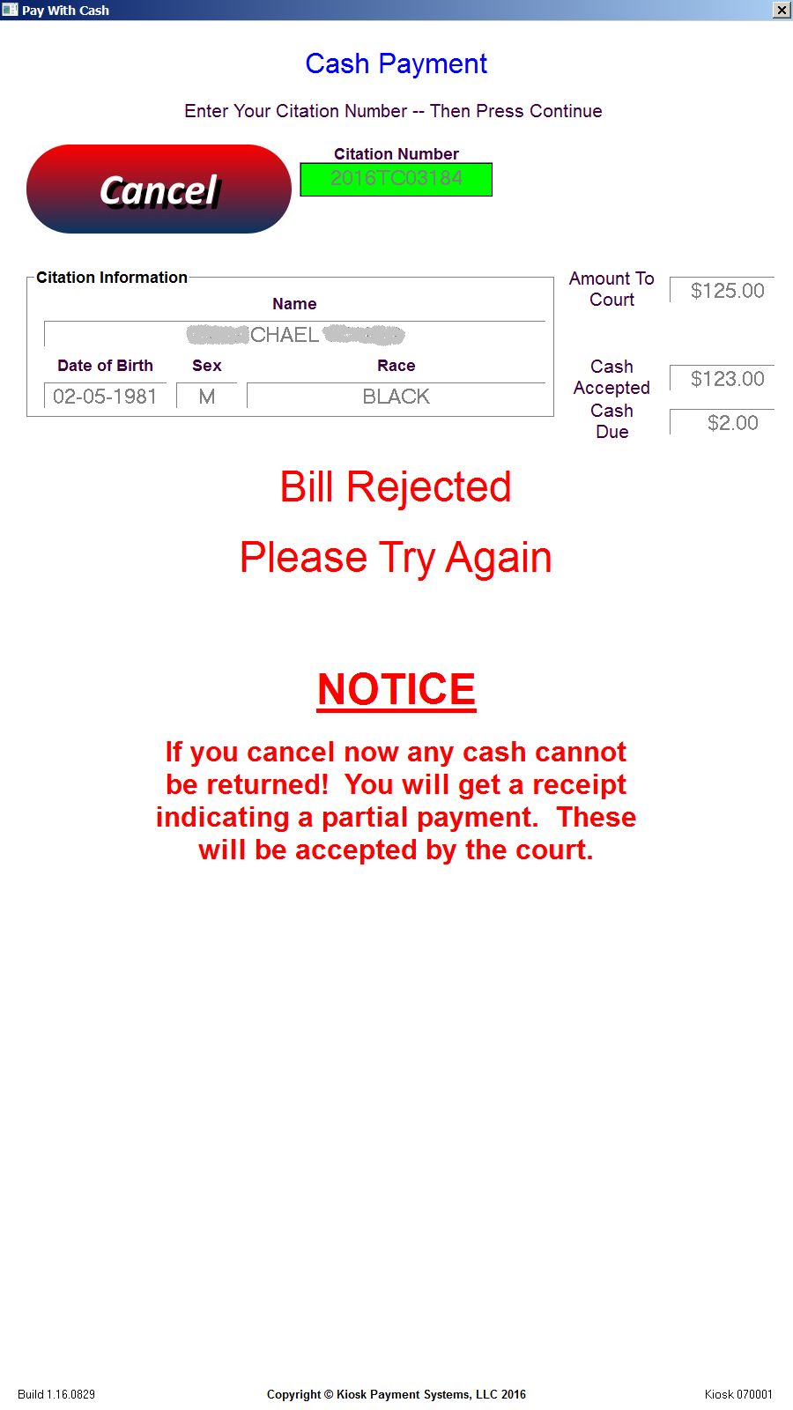
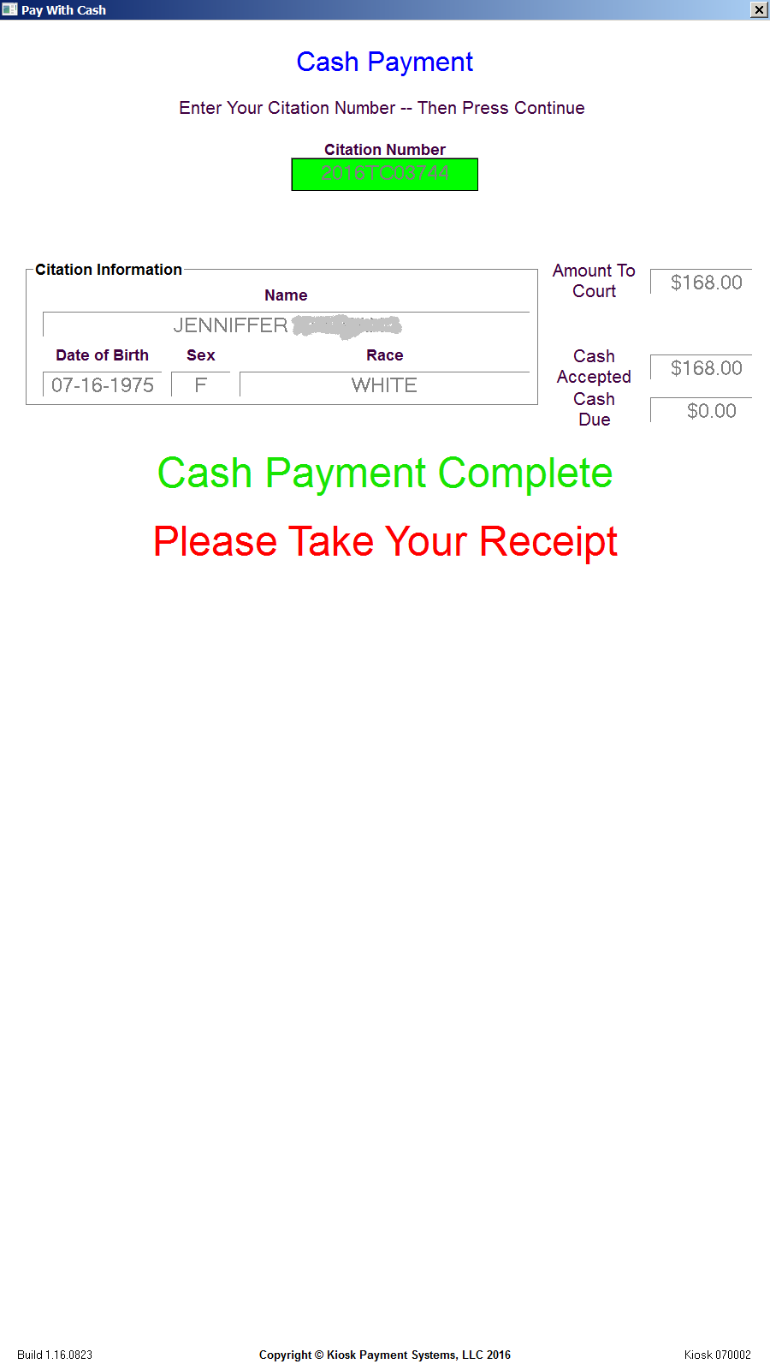
Cash Payment Screenshots

Slide 8
Card Payment Screen
Selecting Pay With Card, the user can then enter the citation, docket or fee number they wish to pay.
After verifying the correct citation to pay, the user will then select or enter an amount to pay.
Once terms are accepted, they will then be prompted to insert their card into the card acceptor.
The card transaction will then be securely processed via standard internet connection.
A receipt of payment will then be printed concluding the transaction.
An email receipt is immediately sent to a predetermined address to ensure a proper record of the transaction.

Slide 9
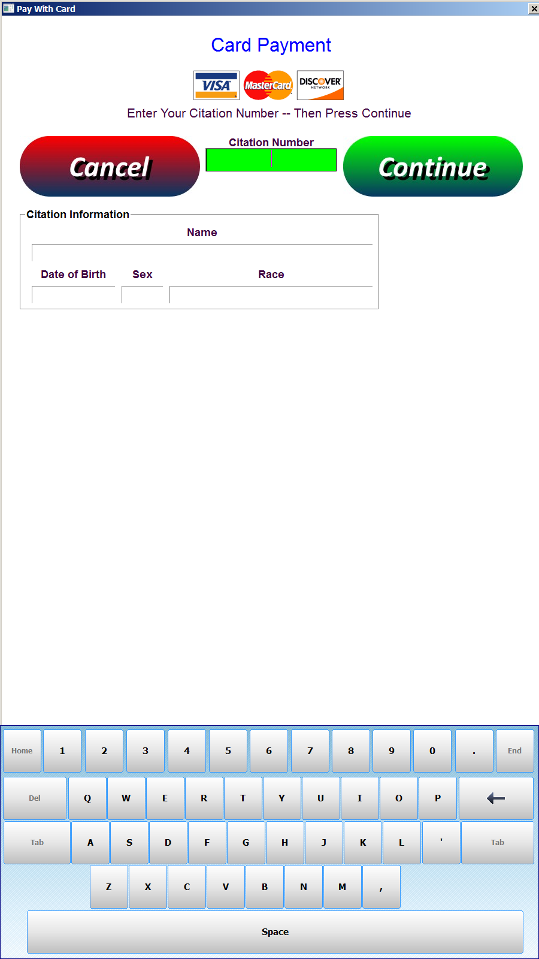
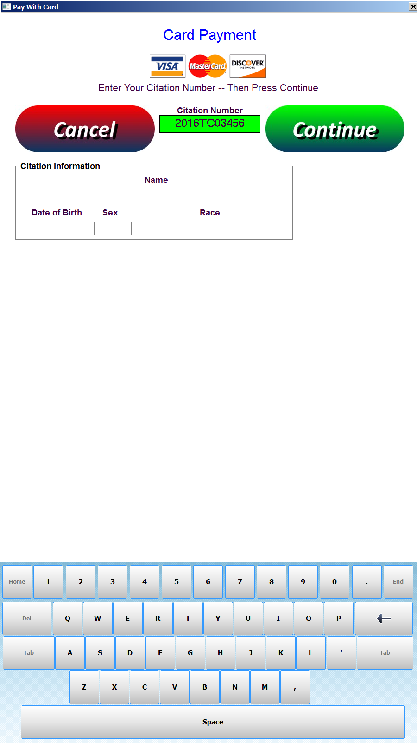
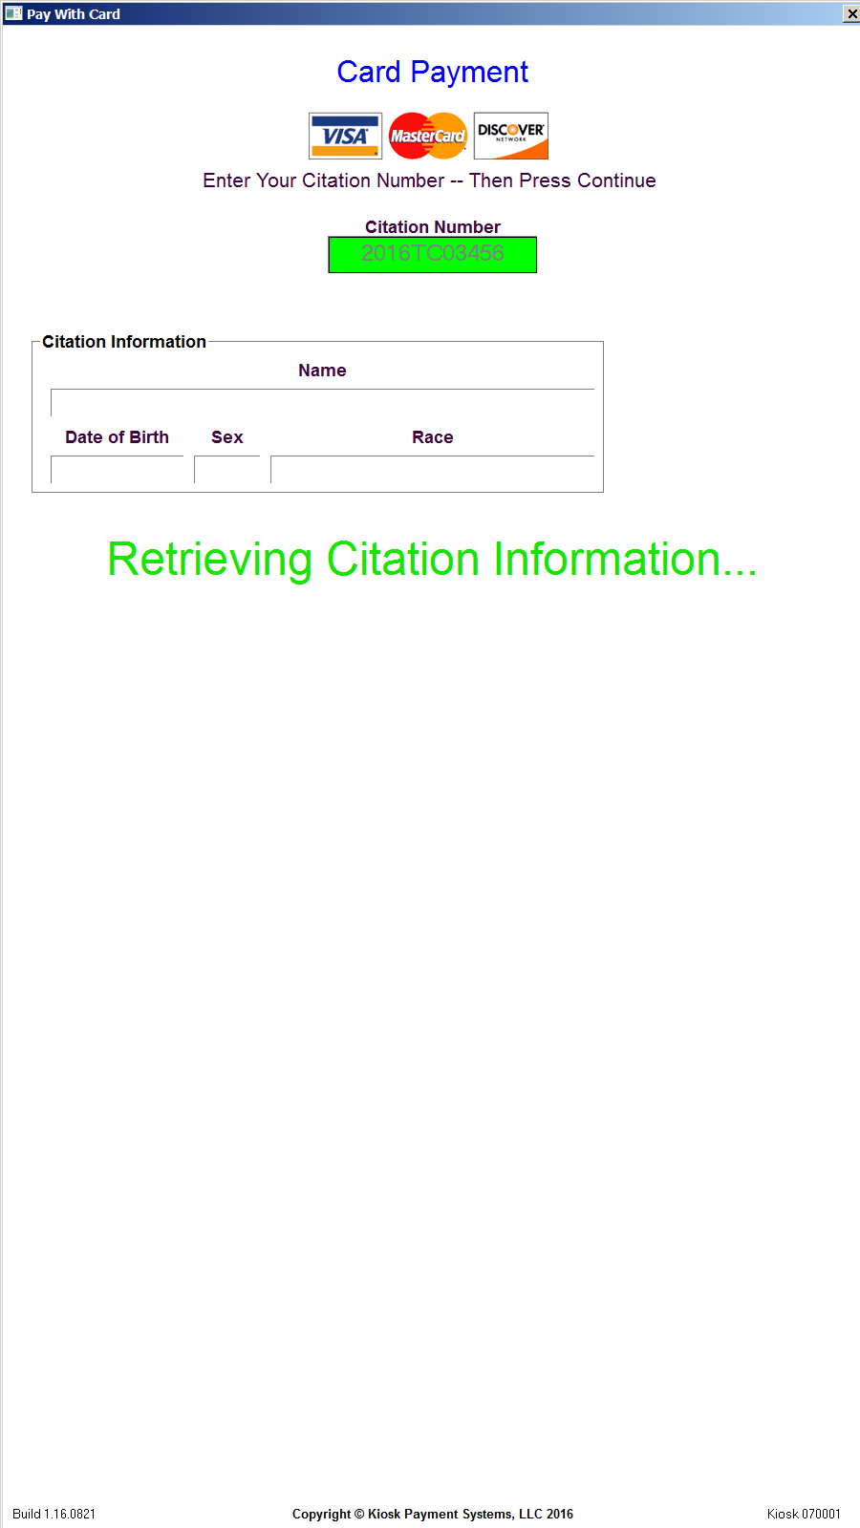
Card Payment Screenshots

Slide 10
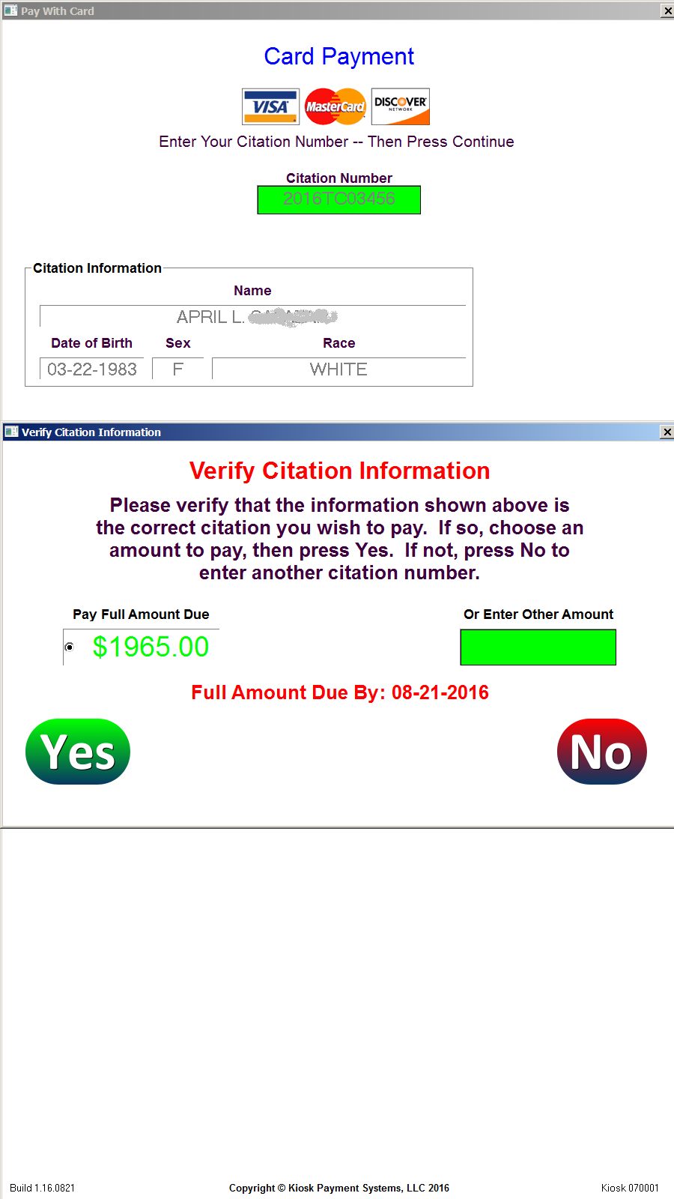
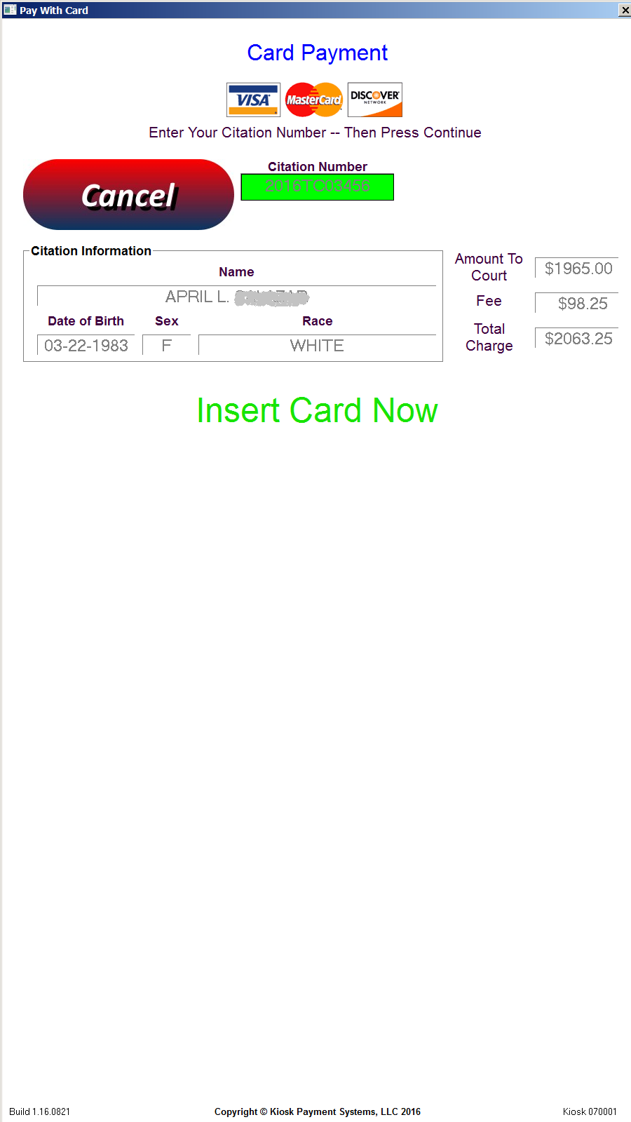
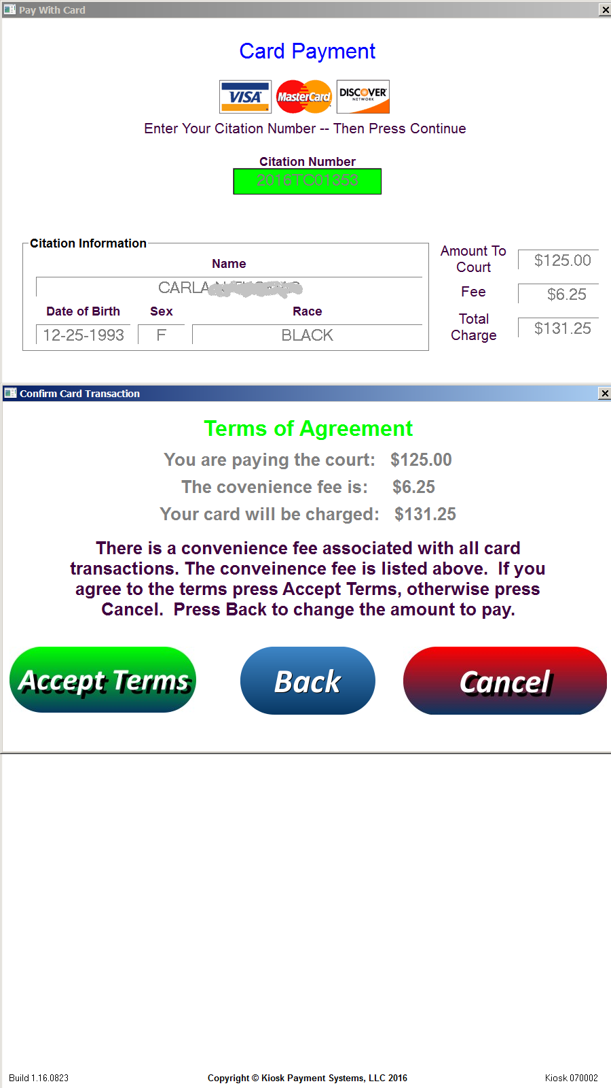
Card Payment Screenshots

Slide 11
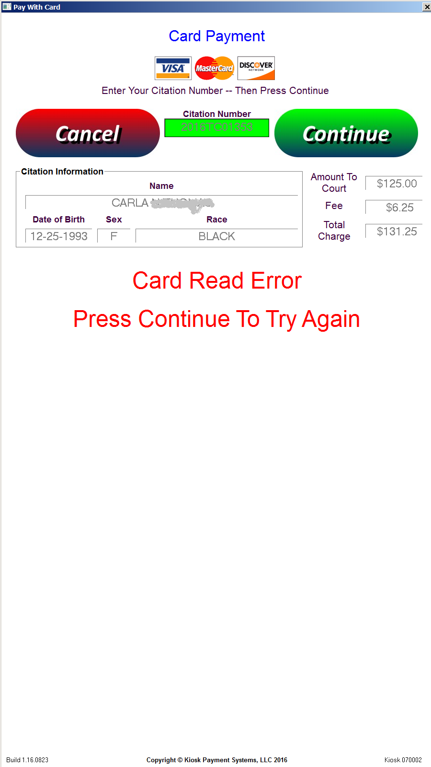
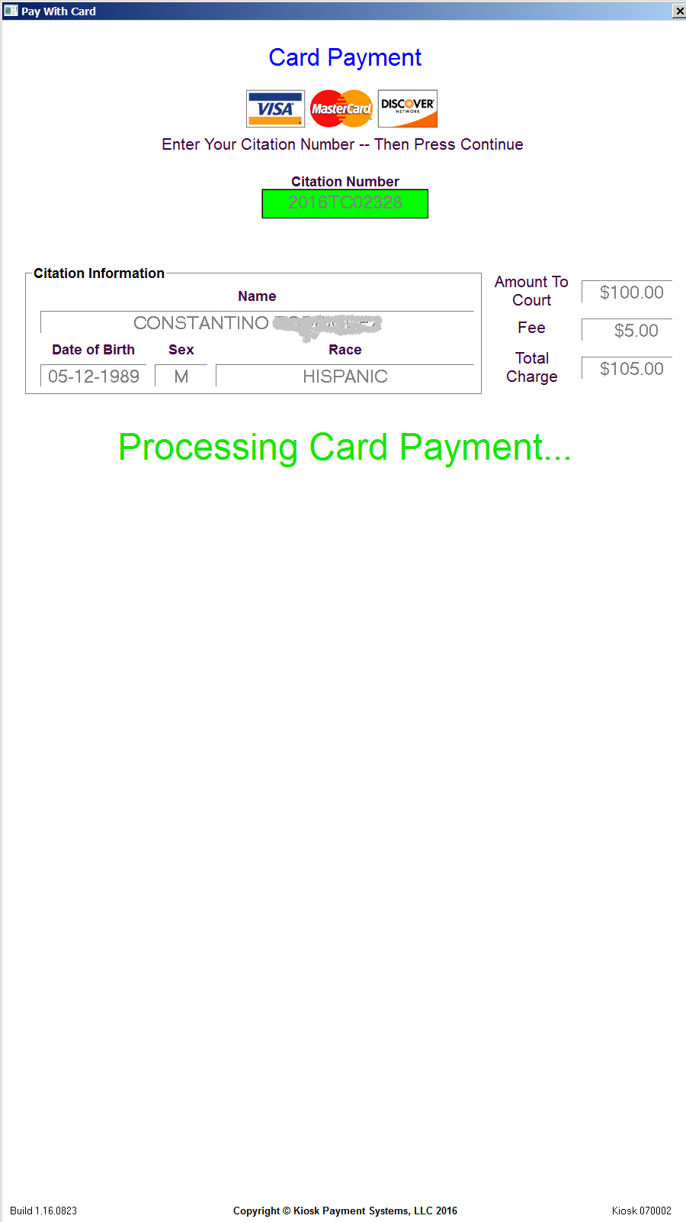
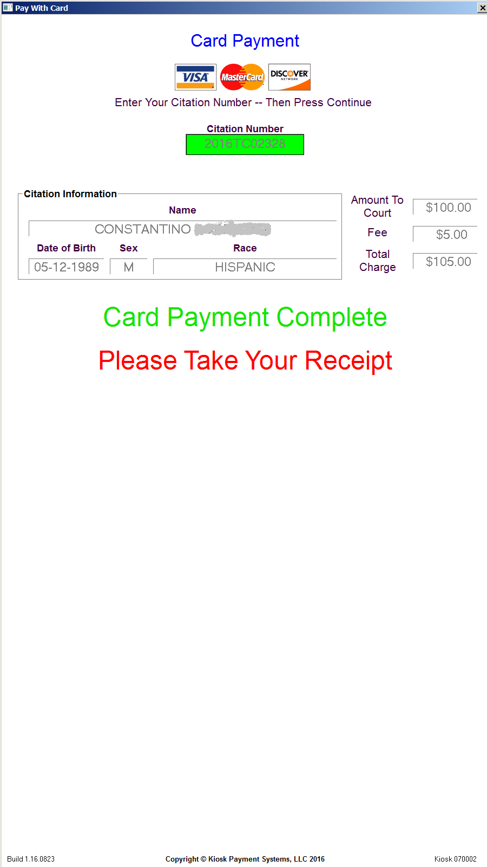
Card Payment Screenshots

Slide 12
Transaction Receipt Printing
Receipt of payment will be printed at the kiosk upon completion of each cash or card transaction.
Additional receipt copies can be printed for each transaction or on demand by authorized users.
An additional receipt will be sent via email once the payment has completed.
Both partial and full payments are accepted and will be indicated as such on the printed and emailed receipts.

Slide 13
Sample Receipts
Kiosk 070002 City Court Of Hammond
Date 08-25-2016 Time 10:26:36
Transaction ID: 070002160825102636
Name: JXXXXXXXX F DXXXXXX
Citation Number: 2016TC03744
Court Payment: $168.00
Payment Fee: $0.00
Payment Total: $168.00
Balance Due: $0.00
Due Date: PAID IN FULL
Cash Payment Complete
Thank You!
Email Copy
Kiosk 070001 City Court Of Hammond
Date 08-25-2016 Time 09:02:29
Transaction ID: 070001160825090229
Name: KXXXXXX J FXXXXXXXX
Citation Number: 2016TC01510
Court Payment: $183.00
Payment Fee: $9.15
Card Charged: $192.15
Balance Due: $0.00
Due Date: PAID IN FULL
Reference Number: 8611354133
Authorization Code: 134094
Card Number: XXXXXXXXXXXX9350
Card Payment Complete
Thank You!
Email Copy

Slide 14
Regular Activity Reporting
Receipts of each transaction are sent via email upon completion of each transaction.
Comprehensive reports of transaction activity will also be sent via email daily, weekly, and monthly.
Credit reports will be sent listing all card transaction with details.
Maintenance reports will be sent daily indicating the amount of cash contained within each kiosk.
Cash reset reports will also be sent whenever a cash reset is performed at the kiosk by an authorized person.
Up to four email addresses can receive these regular activity reports.

Slide 15
Kiosk Software Support
Our software support will ensure the daily logging, function and reliability of each kiosk in production.
Our responsive technicians offer software support 8AM-5PM weekdays via remote connection through the internet.
Regular software maintenance will be performed during off hours so as to not tie up the kiosk during regular operating hours.
Future updates regarding changes in US currency and credit card security audits will be included with regular support.

Slide 16
Summation
The automated cashier kiosks are designed to streamline the handling of court payments while minimizing inevitable human error.
Timely email reporting and transaction detail provided makes our system almost totally automated and corruption resistant while simultaneously reducing paperwork and payroll.
Certain software customizations are available for each agency.
A wired internet connection and power outlet is all that is needed for operation and support.
Video surveillance of each kiosk location is recommended for additional security and fraud deterrence.

Slide 17
Contact Information
For additional information and pricing, please contact:
Stuart Murphy
985-969-4201
stuart.murphy@kioskps.com

