Slide 1
Kiosk Payment Systems, LLC

Slide 2
Payment Options Accepted
The kiosk allows users to make full or partial payments of court fines by cash or card.
All dollar denominations are accepted ($1, $2, $5, $10, $20, $50 & $100).
All credit/debit/charge cards are accepted.
Card processing is through Bluepay using a standard internet connection supplied by hosting agency.

Slide 3
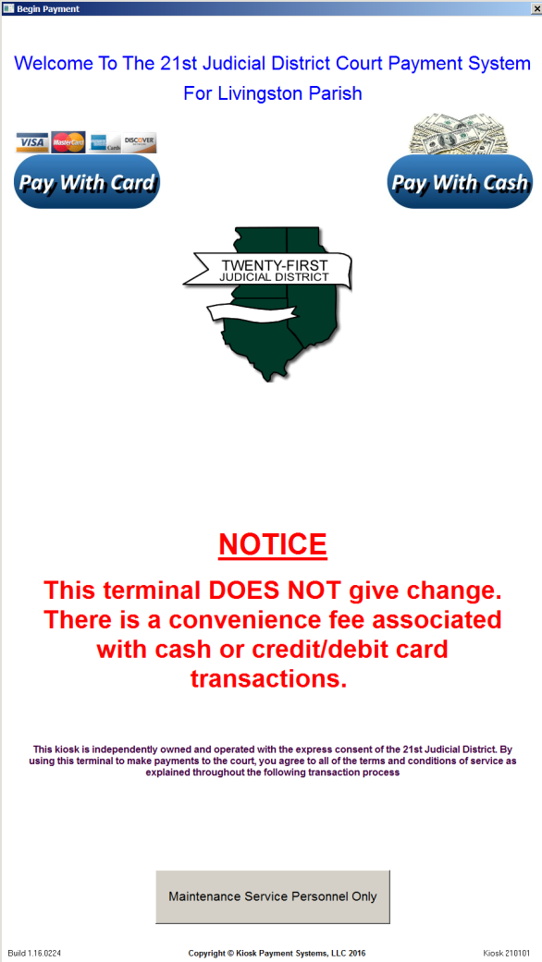
Main Payment Screen
The Main Screen allows users to select which payment option they choose to use, either Pay With Cash or Pay With Card.

Slide 4
Cash Payment Screen
Selecting Pay With Cash, users will enter their first name, last name, docket/citation number, and amount to pay.
After pressing Continue, they will then be prompted to accept terms.
Once terms are accepted, they will then be told to insert cash into the cash acceptor.
All cash denominations are currently accepted by the cash acceptor (in US dollars).
Counterfeit bills, mutilated money, and foreign denominations are immediately rejected by the cash acceptor.
Cash is deposited and secured in a locked cannister within the kiosk.
Two receipts will then be printed concluding the transaction.

Slide 5
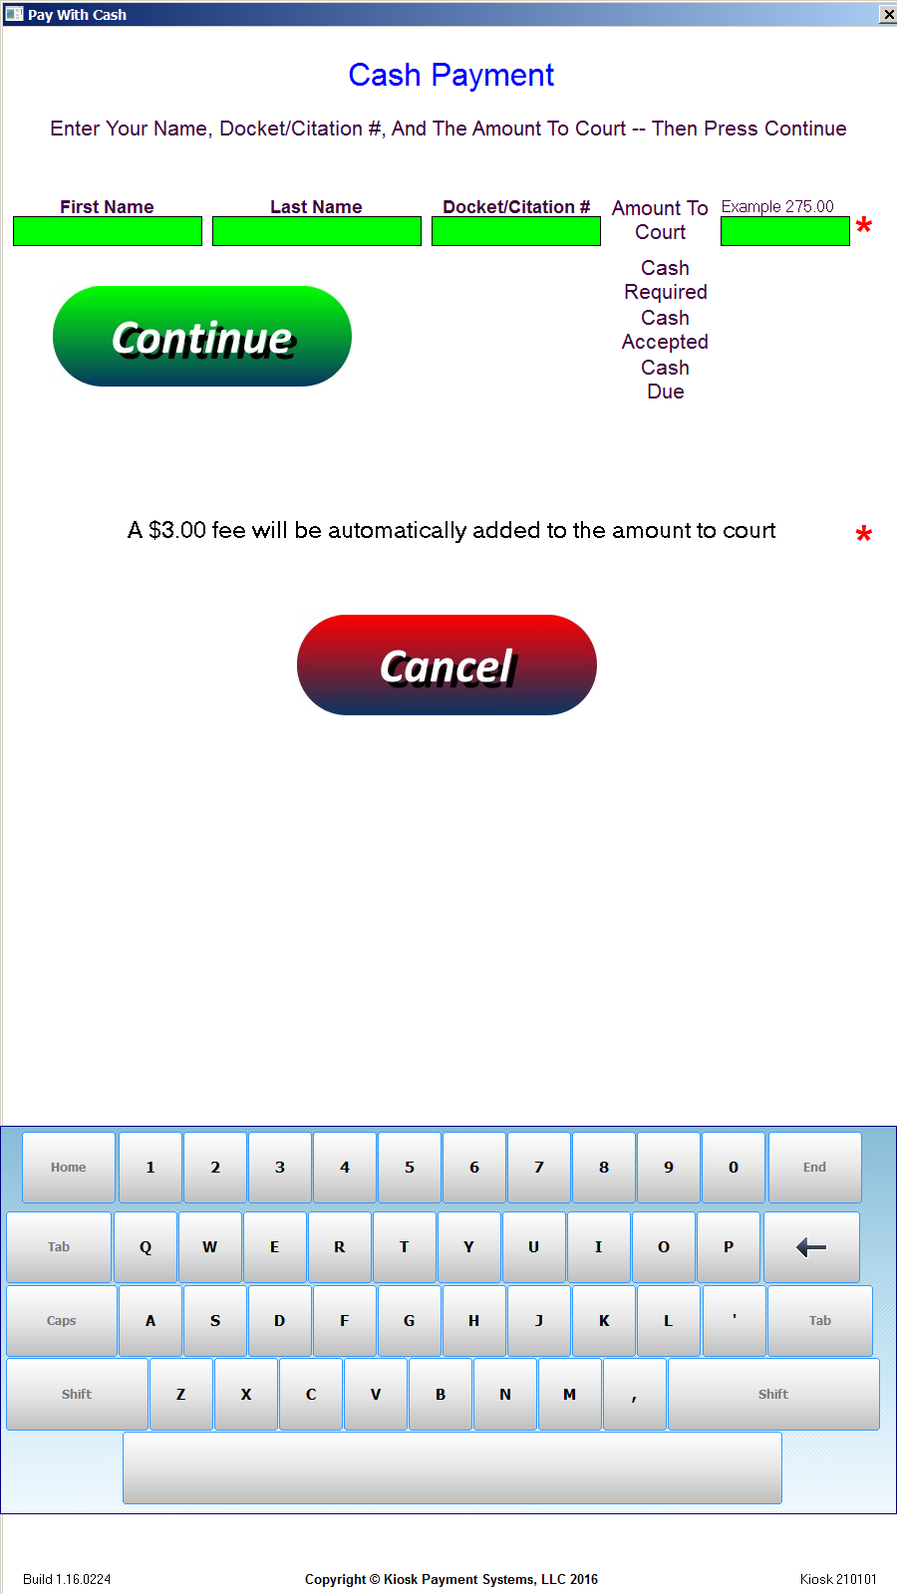
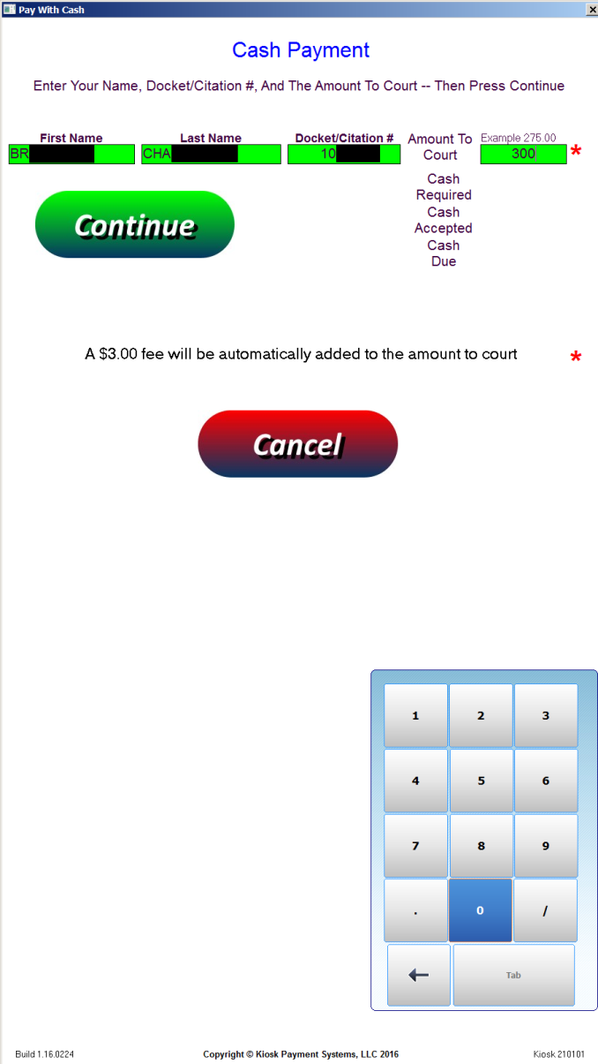
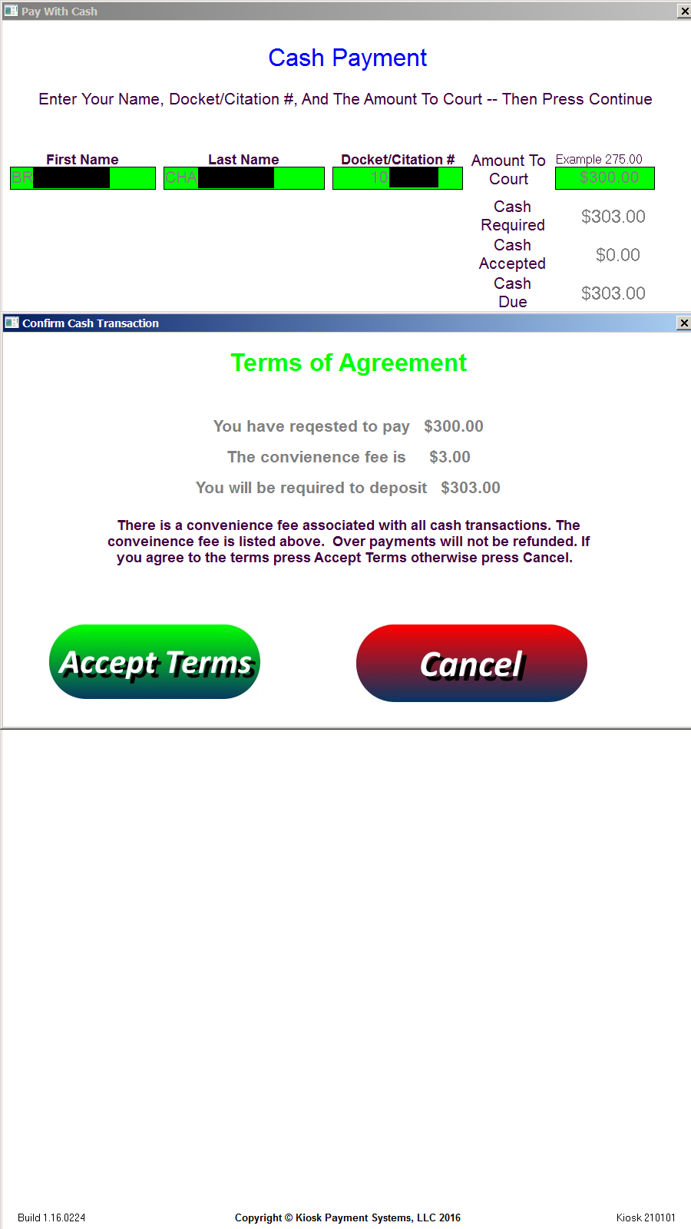
Cash Payment Screenshots

Slide 6
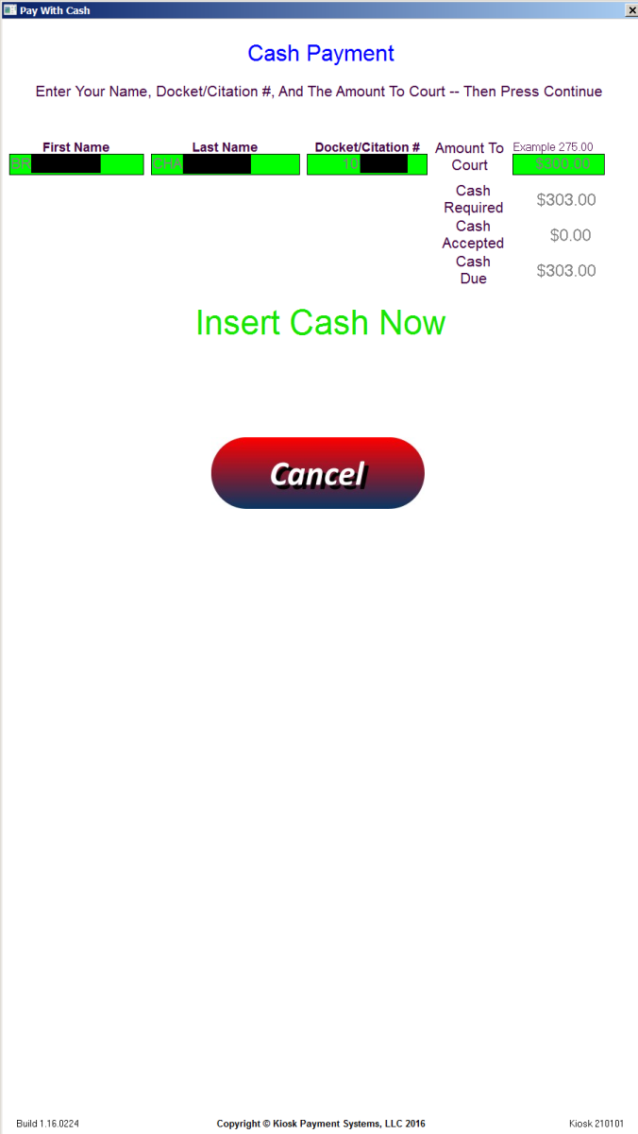
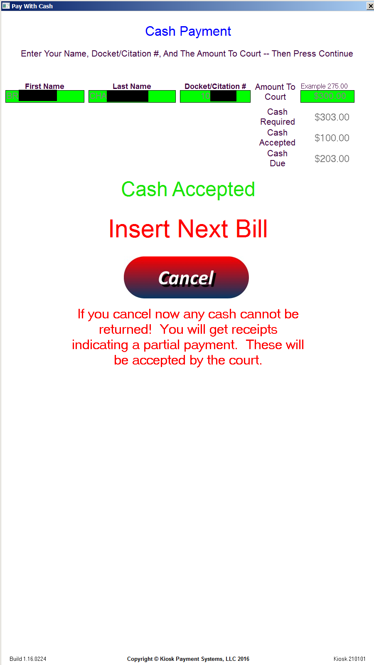
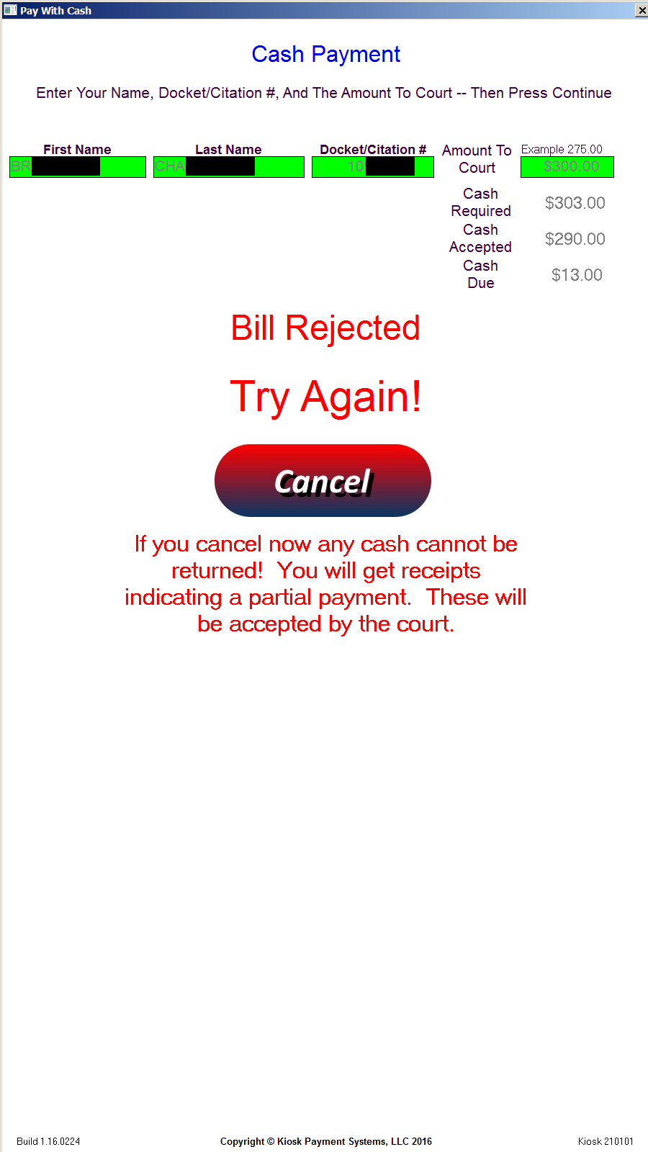
Cash Payment Screenshots

Slide 7
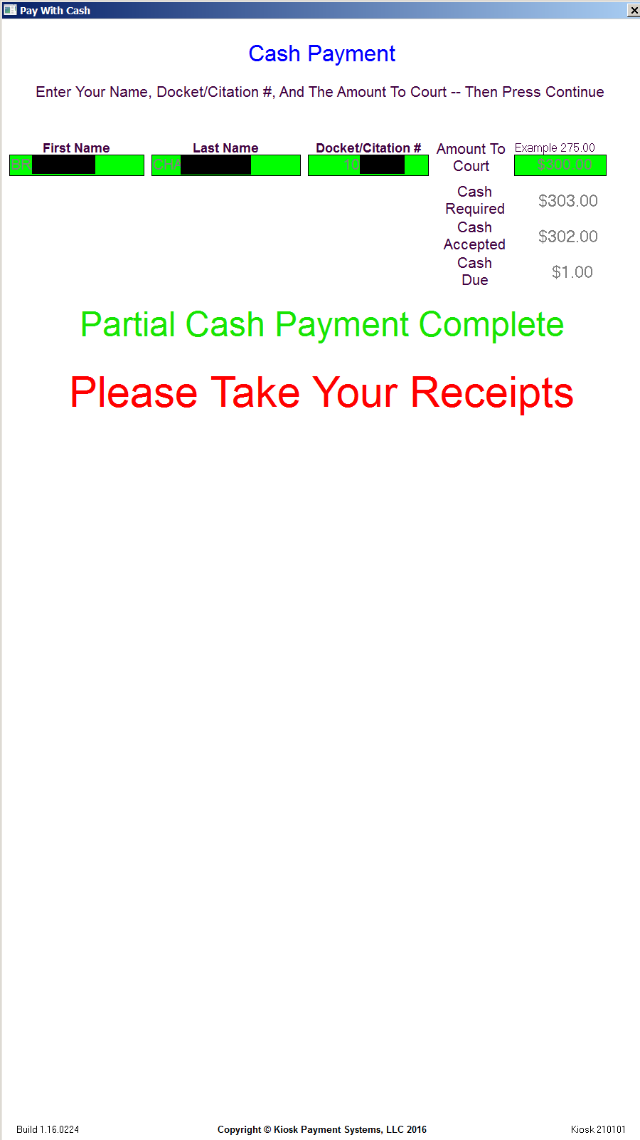
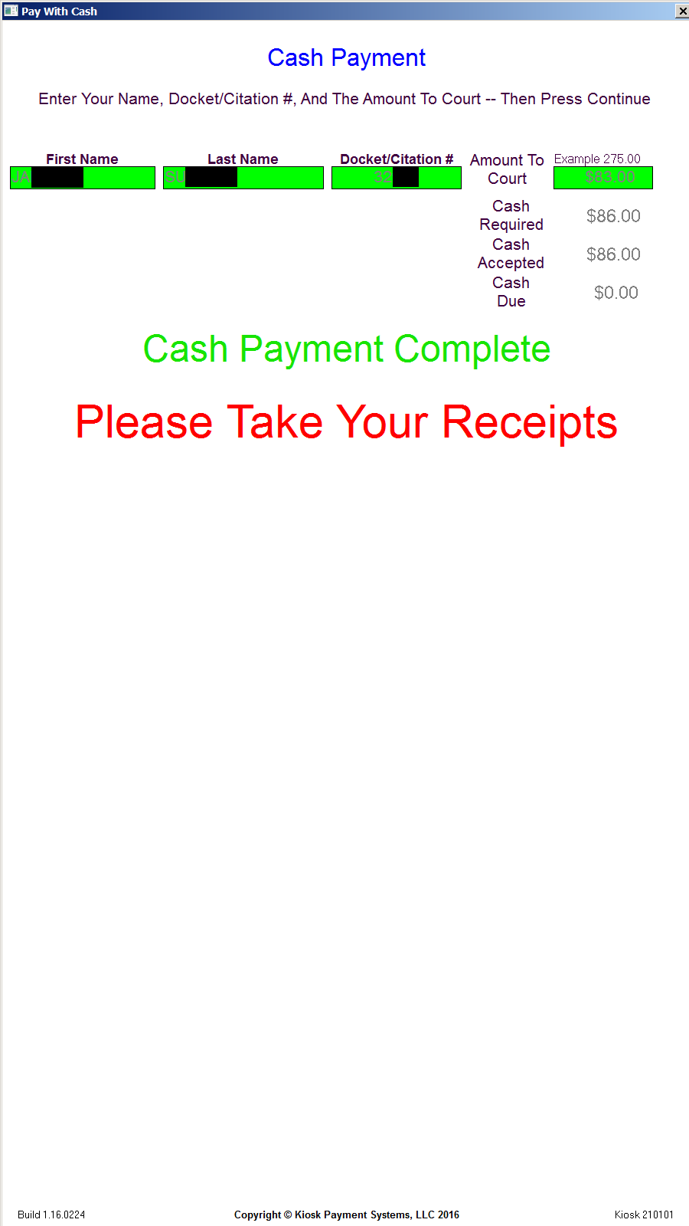
Cash Payment Screenshots

Slide 8
Card Payment Screen
Selecting Pay With Card, users enter their first name, last name, docket/citation number.
After pressing Continue, they will then be prompted to accept terms.
Once terms are accepted, they will then be told to insert a card into the card acceptor.
All card types are currently accepted and processed.
The card will then be processed by Bluepay via the internet connection.
Two receipts will then be printed concluding the transaction.

Slide 9
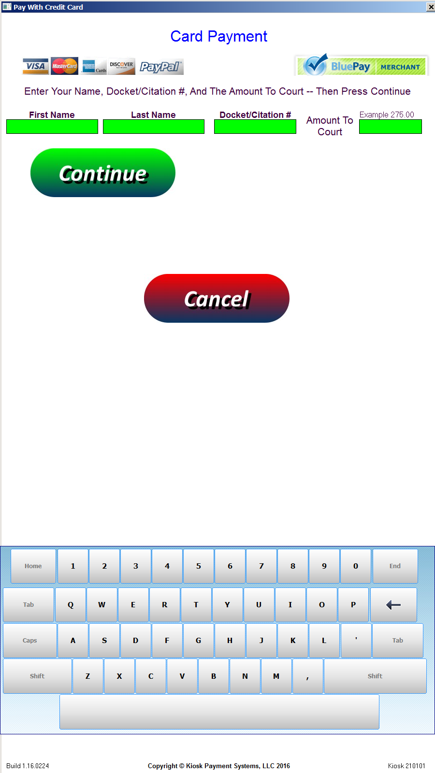
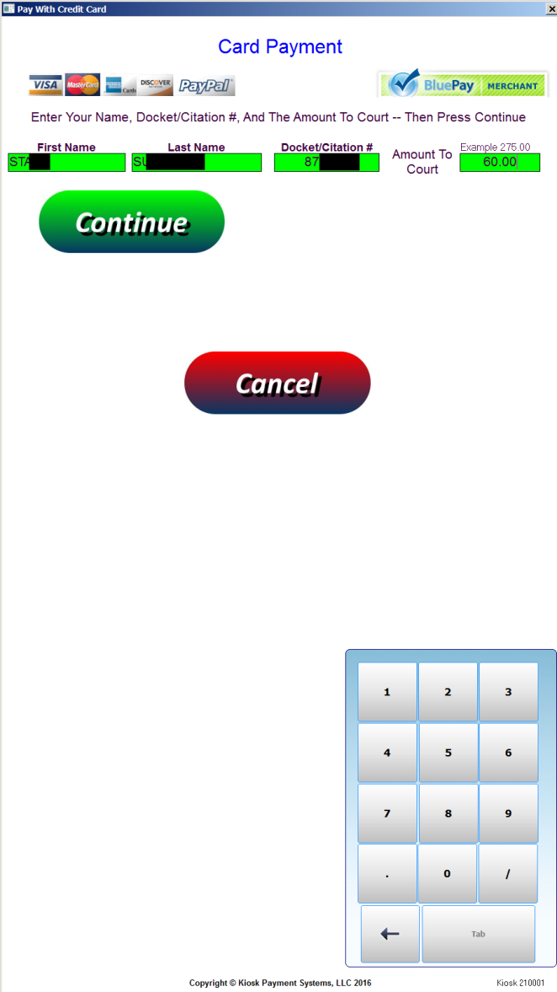
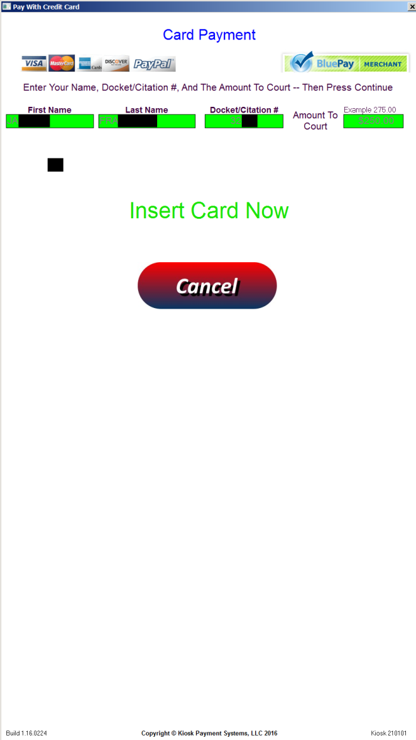
Card Payment Screenshots

Slide 10
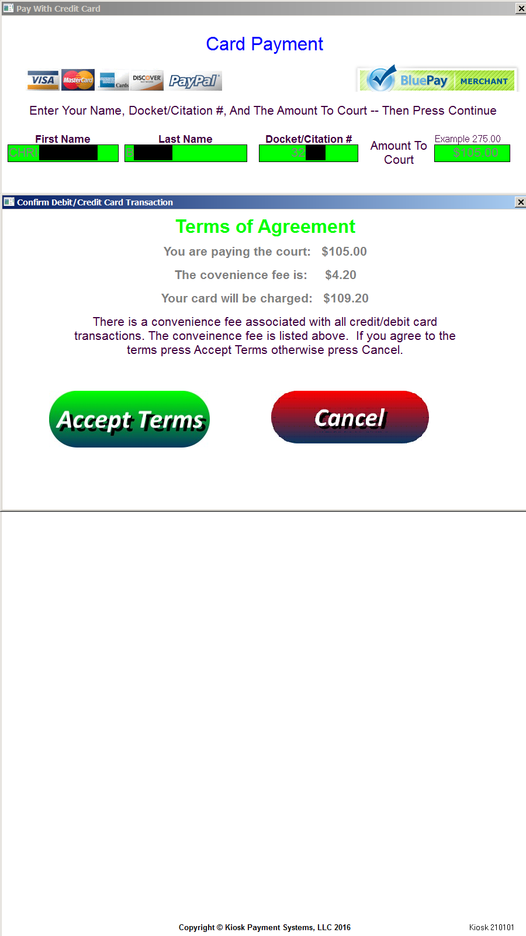
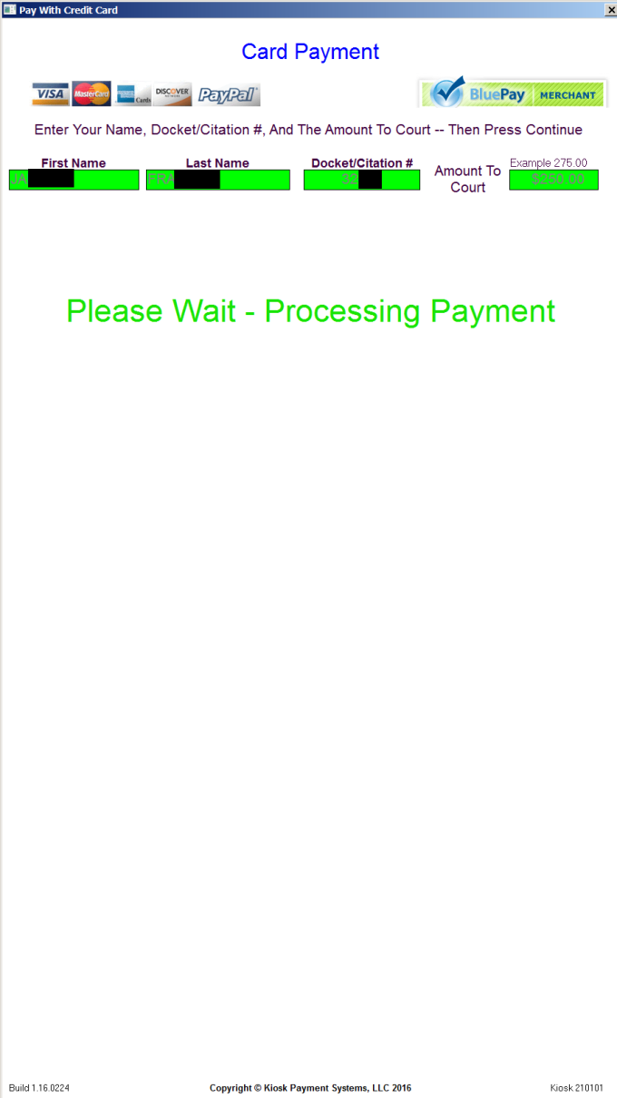
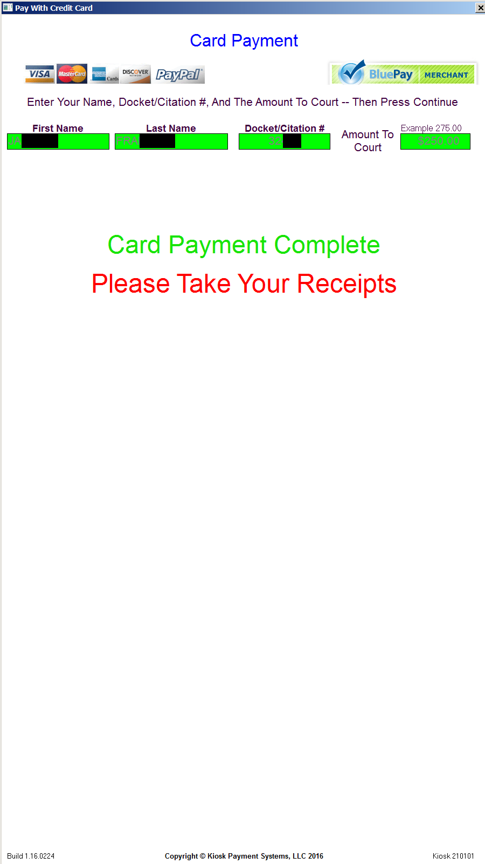
Card Payment Screenshots

Slide 11
Receipt Printing
Upon completion of payment by cash or card, two receipts will be printed.
For record keeping, one receipt goes to the court and the other receipt is kept by the user.
Additional receipt copies are sent via email once payment has completed.
Both partial and full payments are accepted by the kiosks and will be indicated as such on the printed receipts.

Slide 12
Regular Activity Reporting
Receipts of each transaction are sent via email upon completion of each payment.
Comprehensive reports of activity will also be sent via email to whomever needs them daily, weekly, and monthly.
Credit and Maintenance reports will be sent daily.
Cash Reset report will be sent whenever a cash reset is performed at the kiosk.

Slide 13
Kiosk Maintenance
Software and hardware maintenance will be required to ensure the function and reliability of each Kiosk in production.
Our responsive technicians offer software support 8AM-5PM weekdays via remote connection through the internet.
Regular software maintenance will be performed during off hours so as to not tie up the kiosk during regular operating hours.
Updates regarding future changes in US currency and credit card security audits will be included with regular maintenance.

Slide 14
Summation
Kiosk Payment Systems are designed to streamline the handling of court fines securely while eliminating paperwork and minimizing inevitable human error.
All the reporting and transaction detail provided makes this system almost totally automated and corruption resistant.
The hosting agency will only need to supply power and a working internet connection to the kiosk location.

Slide 15
Contact Information
For pricing and additional information, please contact:
Stuart Murphy
985-969-4201
stuart.murphy@kioskps.com

